Slide 1
Variables, Types and Lists

Slide 2
Learning Objectives
In this chapter, you will learn:
Understand what variables are and how they store values.
Learn about Python data types (integers, floats, strings).
Work on a Budget & Expense Tracker to apply variables in a business scenario.
Learn about lists, how to create and modify them, and apply them in financial data analysis.
Solve a Sales Transactions Exercise using lists

Slide 3
Variables
Variable: A name that represents a value stored in the computer’s memory.
Purpose: Used to access and manipulate data stored in memory.
Reference: A variable stores a reference to the value it represents.
Assignment Statement: Used to create a variable and assign a value to it.
General Format: variable_name = expression
Assignment Operator: The equal sign (=) assigns the value on the right to the variable on the left.
Example: age = 29 (Here, age is the variable, = is the assignment operator, and 29 is the assigned value.)
Notes:
Python Variable is containers that store values.
An Example of a Variable in Python is a representational name that serves as a pointer to an object.
Once an object is assigned to a variable, it can be referred to by that name.
In assignment statement, variable receiving value must be on left side
A variable can be passed as an argument to a function
Variable name should not be enclosed in quote marks
You can only use a variable if a value is assigned to it

Slide 4
Example
x = 5 print(x)
y = 5.0 print(y)
x = 5 # x is an integer x = "Hello" # Now x is a string

Slide 5

Reassigning a Variable
A variable in Python can refer to items of any type
Figure 1 The variable x references an integer
Figure 2 The variable x references a string

Slide 6
Example: Simple Variable Arithmetic
# Basic Variable Arithmetic Example
price = 50
discount = 10
final_price = price – discount
print("Final Price:“, final_price)

Slide 7
Variables Naming Rules
A Python variable name must begin with a letter (A-Z or a-z) or an underscore ( _ ).
✅ Valid: _myVariable, x_value, name1
❌ Invalid: 1name, @value
A variable cannot start with a number (digit)
✅ Valid: var1, x_y
❌ Invalid: 5data, 9score
Variable names can only include letters (A-Z, a-z), digits (0-9), and underscores (_).
No spaces or special characters (e.g., @, #, $, %) are allowed.
✅ Valid: my_variable, score99, _temp_value
❌ Invalid: my-variable, first name, data@home

Slide 8
Variables Naming Rules
Python has reserved words that cannot be used as variable names (e.g., if, else, while, class, def, return).
✅ Valid: _def = 10, if_value = 5
❌ Invalid: def = 10, if = 5
Python variables are case-sensitive, meaning name, Name, and NAME are treated as three different variables.
Example:
age = 25
Age = 30
print(age) # Outputs: 25
print(Age) # Outputs: 30

Slide 9
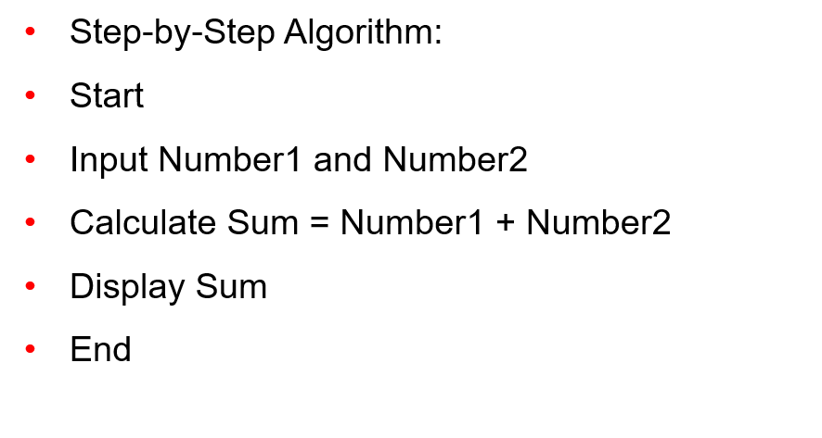
Exercise 1 – Write Code for the Following Algorithm

Slide 10
Python Data Types
Data types are the classification or categorization of data items.
It represents the kind of value that tells what operations can be performed on a particular data.
Since everything is an object in Python programming, data types are classes and variables are instances (objects) of these classes.

Slide 11
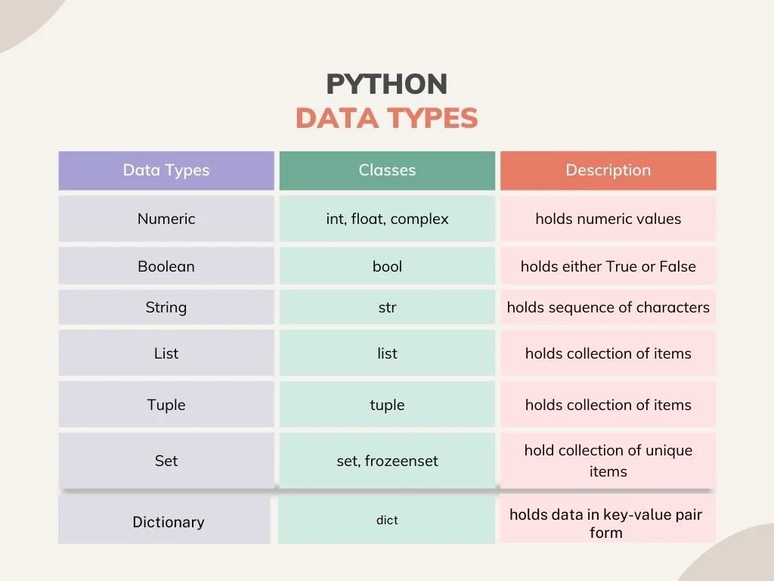
Python Data Types

Slide 12
Python Data Types - Example
Integers (int): Whole numbers, positive or negative
Example: x = 5
Floating-Point (float): Numbers with decimal points
Example: Salary = 2568.50
String (str): A sequence of characters, enclosed in single or double quotes
Example: name = “Bella”

Slide 13
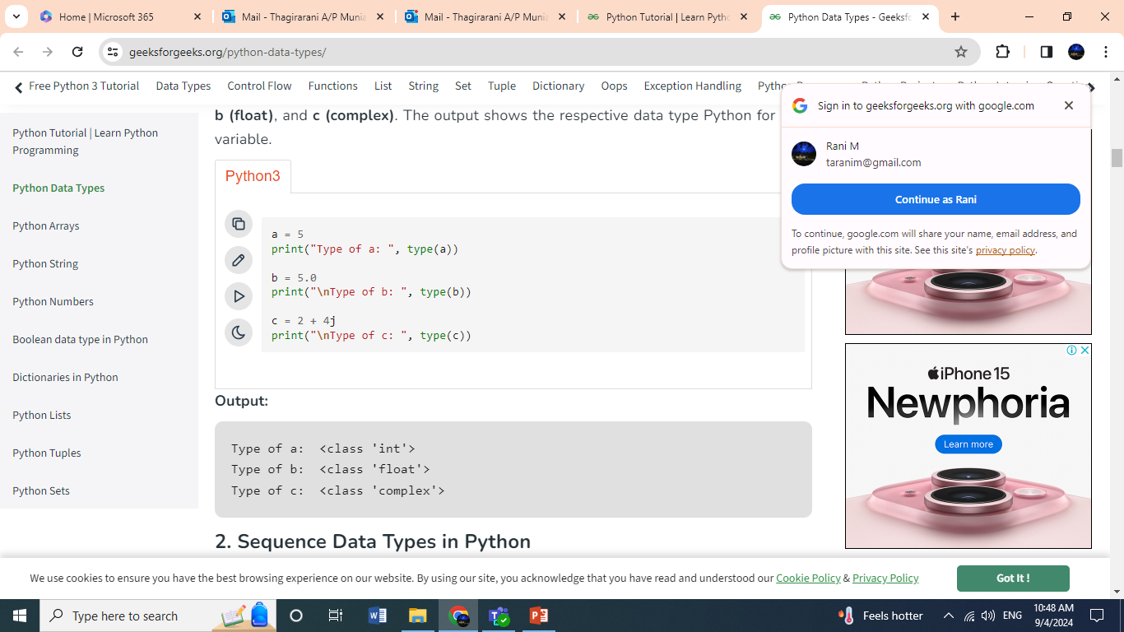
Type () Function
Type() function is used to determine the type of Python data type.

Slide 14
Exercise – Budget & Expense Tracker
A company is managing its budget for business operations. Write a Python program that:
Stores the company name (string).
Stores the total budget for the month (float).
Stores monthly rent expense (float).
Stores monthly salary expense (float).
Stores monthly marketing expense (float).
Calculates the remaining budget after deducting expenses.
Displays all details using print() in a clear format.

Slide 15
Lists in Python
A list is a collection of items that can be of any data type, including other lists (multidimensional lists).
Lists are the simplest containers that are an integral part of the Python language.
Lists can hold any type of item, like numbers, words, or even other lists. You can add as many items as you want.
Lists are mutable, and hence, they can be altered even after their creation.s, enclosed in [ ] and separated by commas.

Slide 16
Example: Business Revenue from Different Branches
A list storing revenue from different business locations
# Revenue in USD from different store locations
branch_revenue = [10500, 13200, 8900, 15600, 9800]
# Accessing revenue of the second branch
print("Revenue of second branch: $", branch_revenue[1])
Notes:
Expenses Tracker
A list of different expense categories in a household or business.
# List of monthly expenses in dollars
monthly_expenses = ["Rent", "Utilities", "Groceries", "Transport", "Entertainment"]
# Accessing a specific expense
print("Major expense category:", monthly_expenses[0])

Slide 17
Example 1: Creating and Using a List
Creating a List: You can create an empty list using square bracket
mylist = [ ] # This creates an empty list
Adding Items: You can add an item to the list using the append() method
mylist.append(1) # This add the number 1 to the list

Slide 18
Example 1: Creating and Using a List
Counting Starts at Zero: Lists start counting from zero. This means the first item in the list is at position 0.
print(mylist[0]) # This prints the first item in the list, which is 1
Using Methods: You can use a period (.) followed by a command to perform actions on the list.
mylist.append(2) # This add the number 2 to the list

Slide 19
Exercise: Shopping Cart with Discount
Task: Create an algorithm to calculate the total price of a shopping cart after applying a discount.
Expected Steps:
Start
Input the total price of items in the cart.
Input the discount percentage (if applicable).
Calculate the discount amount:
Discount Amount = (Total Price × Discount Percentage) / 100
Calculate the final price:
Final Price = Total Price − Discount Amount
Display the final price.
End

Slide 20
Example 2: Creating a List with Multiple Distinct or Duplicate Elements
A list in Python can contain duplicate values, and each duplicate retains its own position in the list.
# Creating a list with duplicate values numbers = [10, 20, 30, 10, 40, 50, 20] # Printing the list print("List with duplicate values:", numbers) List with duplicate values: [10, 20, 30, 10, 40, 50, 20]

Slide 21
Accessing Elements from the List
In order to access the list items refer to the index number.
Use the index operator [ ] to access an item in a list. The index must be an integer.
Nested lists are accessed using nested indexing.

Slide 22
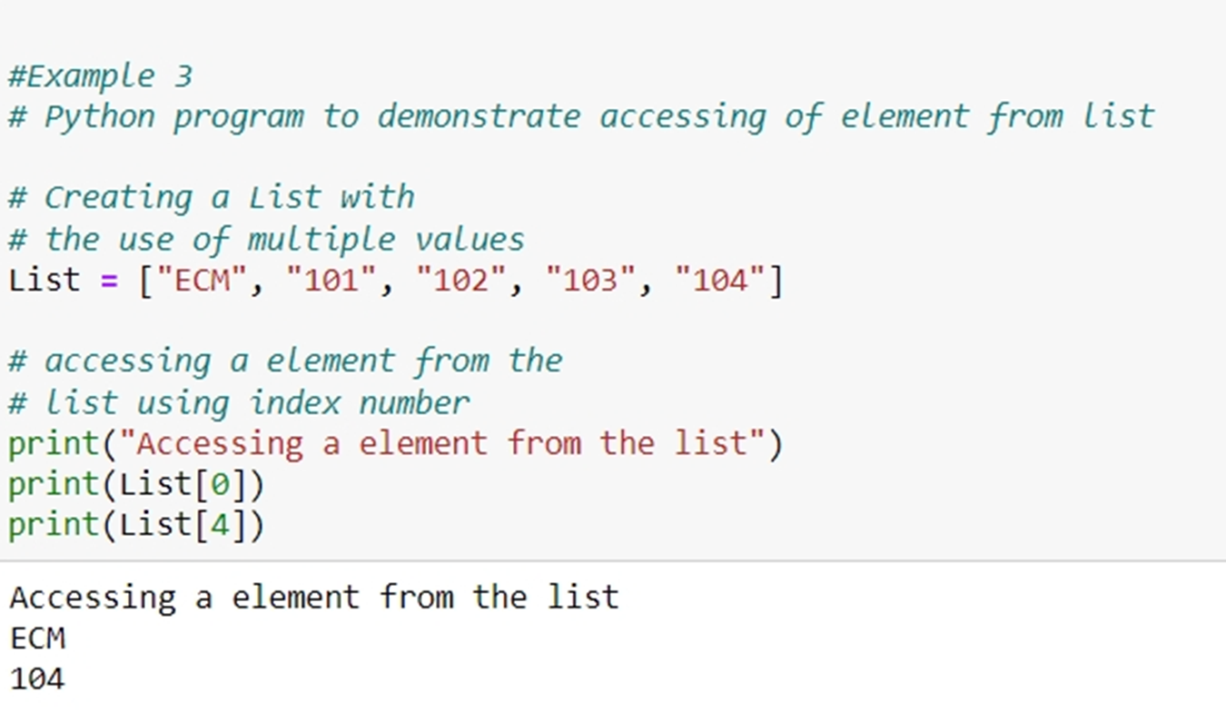
Example 3: Accessing Elements from List

Slide 23
Exercise: Analyse Sales Transactions Using Lists
A store records daily sales transactions in a list. Each transaction represents a sale amount (in dollars). However, some sales amounts appear multiple times (duplicates), as the same item might be sold multiple times in a day.
Your Task:
Create a list called sales that contains the following sales amounts: [150, 200, 350, 150, 500, 300, 200, 400, 150]
Print the entire sales list.
Count occurrences of $200 in sales list.
Calculate and print the total revenue (sum of all sales).

Slide 24
String Concatenation
Python also supports string concatenation and simultaneous variable assignment. Strings can be concatenated with the + operator
Concatenating Strings:
# Numeric addition one = 1 two = 2 three = one + two print(three) # This will output: 3 # String concatenation hello = “hello” world = “world” helloworld = hello + world # Concatenates with a space in between print(helloworld) # This will output: hello world

Slide 25
Simultaneous Variable Assignment
Simultaneous Variable Assignment in Python refers to the ability to assign values to multiple variables in a single line of code using a tuple-like syntax. This allows for more concise and readable code.Concatenating Strings:
x, y = 10, 20 # Assigns 10 to x and 20 to y at the same time
a, b = 3, 4 print(a,b)

Slide 26
Mixing operators
Mixing operators between numbers and strings is not supported
# This will not work! one = 1 two = 2 hello = "hello" print(one + two + hello)
# This will work! one = "1" two = "2" hello = "hello" print(one + two + hello)
# This will work! one = 1 two = 2 print("hello", one + two)

Slide 27
Indentation
Python enforces indentation to represent code blocks. It’s a fundamental aspect of Python’s design and makes code more readable.
Python indentation refers to adding white space before a statement to a particular block of code.
In another word, all the statements with the same space to the right, belong to the same code block
Always use either spaces or tabs, but never mix them. The convention is to use four spaces

Slide 28
Indentation and Code Structure
Statement
if condition:
if condition:
Statement
else:
Statement
Statement
Code block 1 begins
Code block 1 continues
Code block 2 begins
Code block 3 begins
Code block 2 continues
Code block 3 continues
Code block 1 continues
How the interpreter visualize

Slide 29
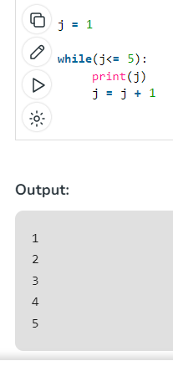
Example
To indicate a block of code in Python, you must indent each line of the block by the same whitespace.
The two lines of code in the while loop are both indented four spaces. It is required for indicating what block of code a statement belongs to.
For example, j=1 and while(j<=5): is not indented, and so it is not within the Python while block.
So, Python code structures by indentation.

Slide 30
Indentation and Code Structure
Common blocks that require indentation:
Conditional statement (if, else, elif)
Loops (for, while)
Functions and class definitions (def, class)
temperature = 30 if temperature > 25: print("It's a warm day.")
for i in range(0, 5): print("Hello World.")
x = 10 if x > 5: print("x is greater than 5") # This line is indented and part of the `if` block

Slide 31
Summary
Variables store values and are dynamically typed.
Print statements output values and text for feedback and debugging.
Lists are flexible data structures used to store collections of items
Indentation is required to define the structure and flow of the code.

Slide 32
Thank you

